Slide 1

By:
Eng. Mohammed I.Alterafi

Slide 2
Introduction
Occupational safety and health known as the science to preserve the safety and human health, by providing a safe working environment free from the causes of accidents , injuries or occupational diseases, or in other words , is a set of procedures, rules and system in a legislative framework aimed at protecting human and property.
Safety is responsibility of everyone in KRC refinery.

Slide 3

YOU ARE
RESPONSIBLE
FOR YOUR
OWN
SAFETY

Slide 4
SAFETY IS
A RIGHT
NOT
A PRIVILEGE

Slide 5
Definitions of Safety Terms
What is safety?
  A condition of being safe.
What is occupational health?
  It is a science to recognize, evaluate and control work place hazards which could impair the health and well being of people at work.
Hazard
  A source of potential harm to people or a situation with potential to cause injury or loss to plant, property or equipment such as:
  Noise
  Poor lighting
  Manual lifting
  Fire
  Electricity

Slide 6
Definitions of Safety Terms (Cont.)
Risk
  Measure of the likelihood that the hazard will cause harm or loss.
Accident
  It is unplanned event which results in harm to people, loss of company assets or damage to the environment.
Near-miss
  It is an event that has potential to result in an accident but for particular reasons this potential is never realized.

Slide 7
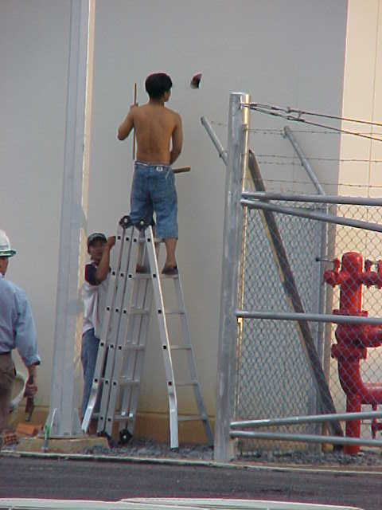
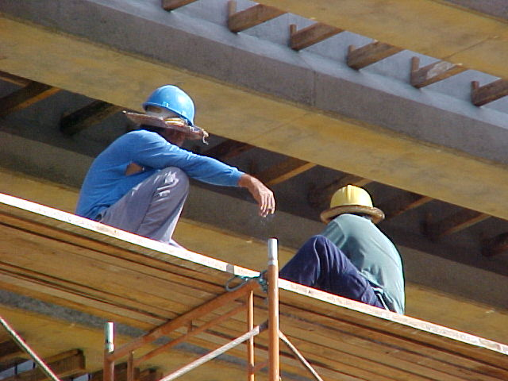
Definitions of Safety Terms (Cont.)
Unsafe act
  An action taken or choice made by an employee that caused an injury to occur such as :
    Using defective equipment
    Using the wrong tool for the job.
Unsafe acts
Unsafe act

Slide 8
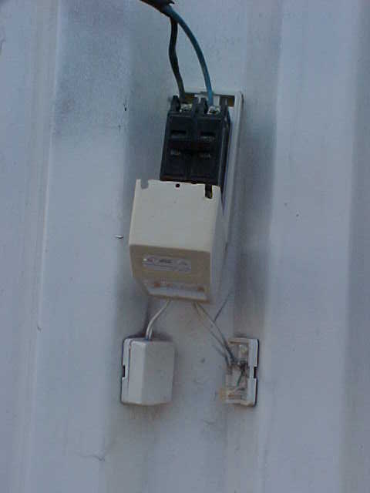
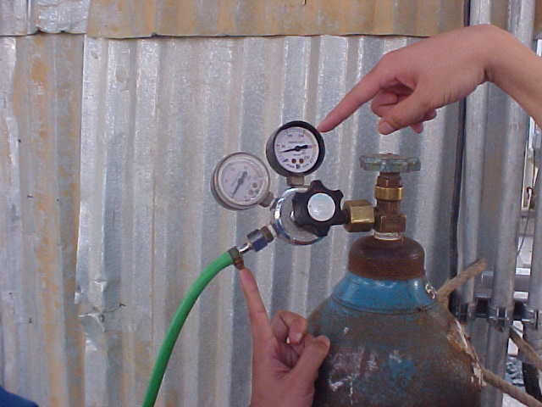
Unsafe condition
  A condition that exists due to equipment failure or equipment/machinery being altered:
    Poor lighting
    Slippery surface
    Poor housekeeping

Slide 9
Definitions of Safety Terms (Cont.)
Proactive
It means taking preventive action before a threat arises, such as:
  Audit program
  Plant checklist
  Inspection
  HSE incentive scheme.
Reactive
  It means taking those specific measures, that will further reduce hazards and injuries.

Slide 10
KRC HSE Policy Statement
Khartoum Refinery Company is committed to prevention of accidents to minimize loss of life or bodily injury to its employees and contractor and damage to environment and physical assets.
In fulfilling this commitment, which is as essential and equally important as cost and production objectives, Khartoum Refinery Company will provide and maintain a safe and healthful work environment and protect the public against foreseeable hazards resulting from its operations by implementing the latest HSE applicable codes and regulations to the design, operation, maintenance and construction of its facilities and/or equipment. HSE goals and objectives will be clearly defined and KRC personnel will be held responsible for achieving these goals.

Slide 11
KRC HSE Policy Statement
(Cont.)
KRC will adopt quality as a mean to perfection for all its process and operations regarding the HSE management system. KRC is committed to provide required logistic supports and required training for its employees to assure continual improvement in all aspects of its fields. Reviews for compliance with this policy will be performed occasionally and corrective action and/or modification will be carried out as required.

Slide 12
HOW TO MANAGE HSE
Management commitment.
Policies & strategic Objectives
Organization, Responsibilities & Resources.
Hazards & Effects Management Process
Standards , Procedures & Documents.
Implementation, Monitoring , Control & review.

Slide 13
General Safety Rules
Never hesitate to ask for assistance.
Report unsafe conditions immediately.
No smoking, except in designated areas.
If you’re not trained, you are not authorized!
Know the safety rules which apply to your job.
Keep your work area clean and orderly at all times.

Slide 14
General Safety Rules
Never take chances. If you're unsure, you’re unsafe!
Wear all personal protective equipment required by your job.
Keep all aisles, stairways, and exits clear obstructions at all times.
Do not participate in horseplay, or otherwise distract fellow workers.
Never begin a hazardous job without being completely familiar with it.
Do not place equipment and materials so as to block emergency exit routes, fire extinguishing systems, or electrical control panels

Slide 15
Good Safety Practices
Inspect work area daily
Be an observer - stay alert
Housekeeping, Housekeeping,
Use your best safety device - THINK
If you’re not sure - ASK someone!!
Report Injuries/Incidents/Illnesses

Slide 16
P.P.E SELECTION
What is PPE?
  Equipment worn by an employee that is designed to prevent injury or illness from a specific hazard.

Slide 17
Protecting Employees from Workplace Hazards
KRC must protect employees from hazards such as falling objects, harmful substances, and noise exposures that can cause injury
KRC must:
  Use all feasible engineering and work practice controls to eliminate and reduce hazards
  Use personal protective equipment (PPE) if the controls don’t eliminate the hazards.
PPE is the last level of control!

Slide 18
Examples of PPE
Body Part Protection
Eye | safety glasses, goggles
Face | face shields
Head | hard hats
Feet | safety shoes
Hands and arms | gloves
Bodies | Coverall, full body suit
Hearing | earplugs, earmuffs

Slide 19
Office Safety awareness
Why office safety?
  Many accidents happen in office due to slips, trips, falls and electrical equipment faults.
  Fire hazard & evacuation of people.
  Legal & moral responsibility for providing safe work place for employees, visitors & contractors.
  Office employees are also part of the company’s safety & health process.
  Office safety acts as a positive reinforcement in overall HSE culture of the KRC.

Slide 20
Office Safety awareness (Cont.)
Workstations:
  Good housekeeping is essential.
  Never store items under your desk.
  Never store items on top of cupboards.
  Never leave desk and/ or filling cabinet drawers open.
Chairs & Desks:
  Good lower support
  Adjustable-knees and hips are level.
  If your desk is too high, compensate by raising the seat height of your chair.
  Never stand on the chair to reach anything, particular if the chair has wheels or is of the swivel kind.

Slide 21
Office Safety awareness (Cont.)
Computers:
  A badly positioned computer not only makes the user unproductive, it also causes discomfort.
  If the monitor is badly positioned the user will probably suffer eyestrain, headache, stiff neck and shoulders, and backache.
  The monitor should be placed directly in front of the user.
  The screen should be 45-50 cm away from the user eyes.
  The top of the monitor should be at eye level to avoid neck strain.
  The keyboard should be directly in front of the user.

Slide 22
Office Safety awareness (Cont.)
Slips, Trips and Falls
Prevent them by remembering the following:
  Do not allow cabling to create a tripping hazard.
  Clear up spillages quickly.
  Keep office area clean.
  Keep stacking and storage areas safe.

Slide 23

Incident Reporting,
Investigation & Follow - Up
Why report and investigate an incident?
To identify the cause of the incident
To prevent re-occurrence
To ensure that statutory and corporate requirements on injury and incident reporting are fully met.
Provide immediate corrective action & lesson learn
Provide information for statistics, analysis, police report and insurance
Provide information for management knowledge and action

Slide 24
Causes of accident
Causes of Accidents.
  Unsafe Acts (Human Factors).
  Unsafe Conditions
Cause Factors /Management Systems.
  Standards & Procedures
  Emergency Planning
  Work Permit System
  Training & Communication
  Design, Maintenance & Inspection.

Slide 25
Who Investigates Accidents?
Supervisor/Foreman.
Safety personnel.
Special committee (pool).
Government agencies.
Specialists or experts

Slide 26
Investigation Steps
Respond to the site.
Preserve The Site.
Collect Information/Evidence.
Analyze Causes.
Recommendations/Corrective Actions.
Prepare Report.
Follow-up on Recommendations

Slide 27
Housekeeping
Benefits of good housekeeping:
  Eliminates fire and accident hazards.
  Maintains safe, healthy work conditions.
  Save time, materials , money, space, and effort.
  Improves productivity and quality.
  Boost morale.
  Reflects a well-run organization.

Slide 28
Housekeeping (Cont.)
Costs of poor housekeeping.
  Slips, trips, and falls.
  Fire.
  Chemical and machine accident.
  Injuries from electrical problems.
  Collisions and falling objects.
  Health problems.

Slide 29
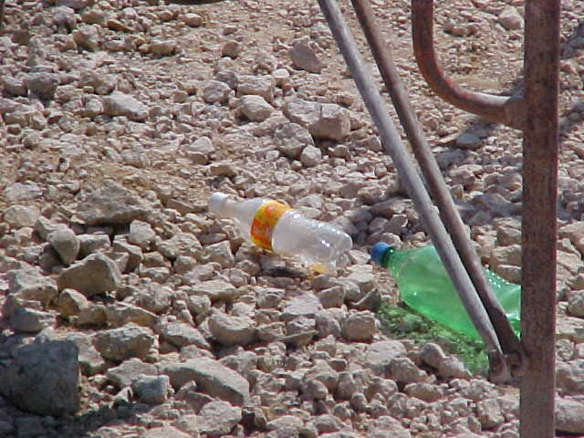
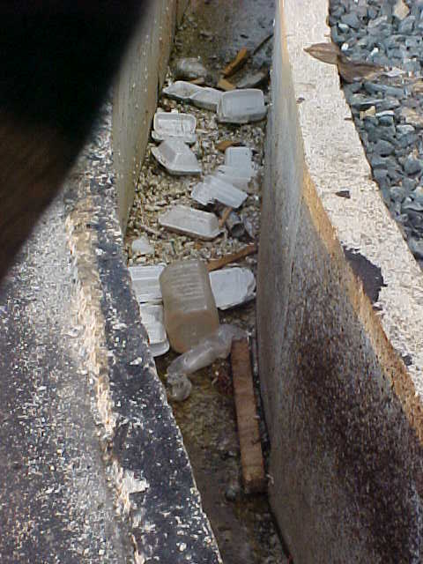
Bad Housekeeping e.g.

Slide 30
Main Causes of Vehicle Accident
SPEEDING
Lack of driving skills
Dangerous overtaking
Bad driving habits
Carelessness
Bad vehicle mechanical condition
Poor road condition
Driving in fatigue

Slide 31
Safe & Good Driving Practices
Adequate safety equipment fire fighting, flashlight and emergency signage).
Wear safety belt .
Authorization of driving.
If you trouble, pull your car at a safe side.
Warn other traffic by setting up reflecting triangle at 300 feet behind your car.
No overtaking in a poor visibility.
Maintain sufficient distance behind front car.

Slide 32
safety measures for warehouse workers’ general safety:
The warehouse must be well ventilated.
All floors, aisles and surfaces must be free of clutter, hoses, spills, electrical cords and other materials or factors that could cause slips, trips or falls.
Workers who have to perform physical work must have enough periodic rest breaks to avoid fatigue.
Always wear the appropriate PPE when at work in a warehouse.

Slide 33
safety measures for warehouse workers’ general safety (cont.)
All newly-hired employees must receive both general ergonomics training and task-specific training.
Every employee must be trained on how to avoid heat stress in hot and humid environments.
Make sure all employees have up-to-date, equipment-specific training and warehouse safety training. Lack of training can turn a 10-second job into a $10,000+ nightmare.

Slide 34
Safe Lifting
If the manual handling risk cannot be eliminated and it is not practicable to use mechanical aids use the correct safe lifting technique to help prevent injury.
Plan the Lift
  Try to break down the load into smaller parts.
  Check the pathway for any obstacles and clear these. Check if any doors need to be opened.
  Test the weight of the load by lifting one corner. If it is too heavy or awkward, stop and request help.

Slide 35
Safe Lifting (cont.)
Performing the Lift
  Stand with feet width apart and in a staggered stance
  Move in close to the load
  Bend your knees, keep your head upright and maintain the spine’s natural Curves
  Pull the load close to your body
  Secure your grip
  Use a smooth controlled motion to lift the load
  Avoid twisting or turning your body when lifting and be sure to use your feet to change direction

Slide 36
Safe Lifting (cont.)
Setting the Load Down
  Stand with your feet apart and in a staggered stance
  Get as close as possible to the area you will place the load
  Bend your knees, keep your head upright and maintain the spine’s natural Curves
  Keep the load close
  Once the load is where you want it release your grip. Always ensure that the load is secured before you release your grip

Slide 37
DISASTER CONTROL PLAN
Disaster defined as an emergency which poses a more serious threat to the safety, witch can not be under normal control.
Disaster control plan outlining the duties and responsibilities of individuals, units and departments during disaster situation.
A disaster can be any one of the following:
  Serious fire in process area –tank farm –power plant…etc.
  Large explosion.
  Large gas cloud.
  Oil spillage.

Slide 38
Objectives of the plan
Rescue and treatment.
Safeguard other personal.
Minimize damage and environmental aspects.
Control incident.
Investigation the root causes of the incident

Slide 39
DCP (Disaster Command Post)
It is a vehicle outfitted with facility maps, communications, and support information. Its crew (PO Mgr & Deputy, (Utility Mgr & Deputy in case of utility incidents), MC Mgr &Deputy, and HSE Mgr & Deputy) can direct the incident.
DCP Commander, PO or DPO Mgr. or (Utility Mgr & Utility DM in case of utility incidents), His decisions are final and should not be over ruled except by DCC Mgr. (refer to disaster control plan KRCM:04).
DCP Commander determines the need for evacuation.
This equipment provides the means for contact with the DCC and for field coordination. DCP must be at a safe location designated by the Incident Commander

Slide 40
DCC (Disaster Command Center)
It is a location where the incident scene can be directed and monitored .
It is a centralized location for monitoring the facility response and also serves as a command center for coordinating all communications.
Meeting room (Dispatch Centre) shall be established as Disaster Command Centre (division heads), TM or DTM shall be in charge, in case of his absence GM or DGM or any top management must initiate the plan. (refer to KRCM:04)

